Slide 1

Group - 11
About Us
01
02
03
AU2040014 Jay Patel
AU2040021 Dhanya Mehta
AU2040265 Spandan Shah

Slide 2

Ahmedabad University
Small Object Detection
Using EfficientDet & QueryDet Baseline deep learning models
Guide:
Prof. Mehul Raval
CSE541 + CSE523
Year 2023

Slide 3
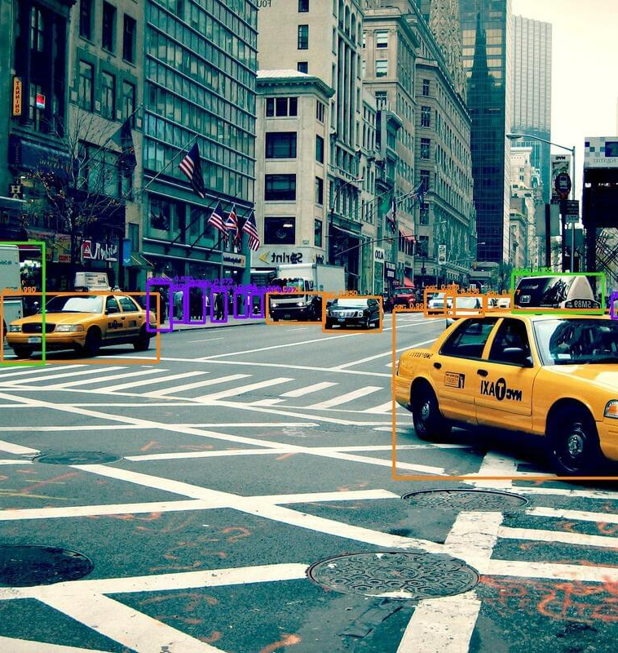
Introduction
Small Object Detection
Evaluate performance of various object detection techniques (in case of small objects) on AU Drone dataset

Slide 4
Existing body of work
Effcient Detection D7
We choose this model as it is better in maximizing feature extraction of image and gives good accuracy.
Efficient Detection D0
Query Detection
This model is developed by google for multi object detection
we trained our model in visdrone instead of coco.
There are seven layers of feature extraction heirarcy and we selected the baseline model as D0
This model tells about small object detection by querying discriminative features.
using query guided feature aggregation it improve detection accuracy while maintaining efficiency.

Slide 5

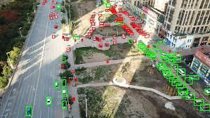
researched about existing model and architecture for small object detection
Picked the three model for now, EfficientDET D0, D7 and queryDet
Pickup the readymade dataset of VisDrone
converted the dataset of COCO into tf-record.
Implemented the model and evaluated the performances like AP, Average Recall,IoU and precession .
our Approach

Slide 6
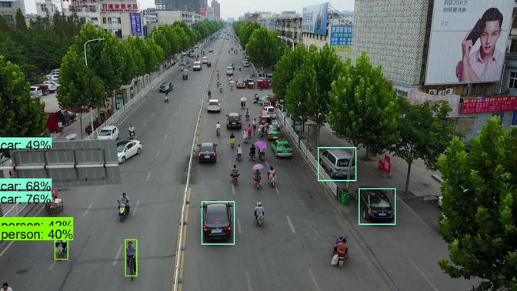
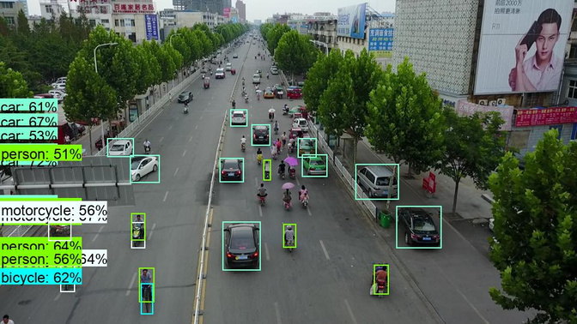
EfficientDet D0
Initial Results
AP
AP .50
AP .75
AR 100
60
EfficientDet D7
40
20
0
QueryDet
EfficientDet-d0

Slide 7
Analysis
01
02
03
AP (Average Precision)
Average Recall
Intersection over Union
Measures the precision-recall trade-off of an object detection algorithm.
Evaluating the overall performance of an object detection algorithm on a dataset
Measures the recall of an object detection algorithm at a fixed level of precision.
Measuring the recall performance of an object detection algorithm
Measures the overlap between a predicted bounding box and a ground truth bounding box.
Evaluating the accuracy of object localization in object detection

Slide 8

Role of each group member in the project and Future work
Jay Patel
Understanding the Coding Structure of Deep Learning
Coding implementation
Dhanya Mehta
Coding
understanding of Model architecture
Spandan Shah
Literature Survey
Data conversion of CoCo into tf record
Future Work:
further implementation of models.
implement more performance metrices and add confusion metrices of all models
Evaluate and test the model AU data.

Slide 9
References
01
02
03
EfficientDet - Tan, M., Pang, R., & Le, Q. V. (2020, July 27). EfficientDet: Scalable and efficient object detection. arXiv.org. Retrieved March 2, 2023, from https://doi.org/10.48550/arXiv.1911.09070
QueryDet - Yang, C., Huang, Z., & Wang, N. (2022, March 24). Querydet: Cascaded sparse query for accelerating high-resolution small object detection. arXiv.org. Retrieved March 1, 2023, from https://arxiv.org/abs/2103.09136
MetrixNet - Rashwan, A., Agarwal, R., Kalra, A., & Poupart, P. (2020, January 9). Matrixnets: A new scale and aspect ratio aware architecture for object detection. arXiv.org. Retrieved March 3, 2023, from https://doi.org/10.48550/arXiv.2001.03194

